Slide 1
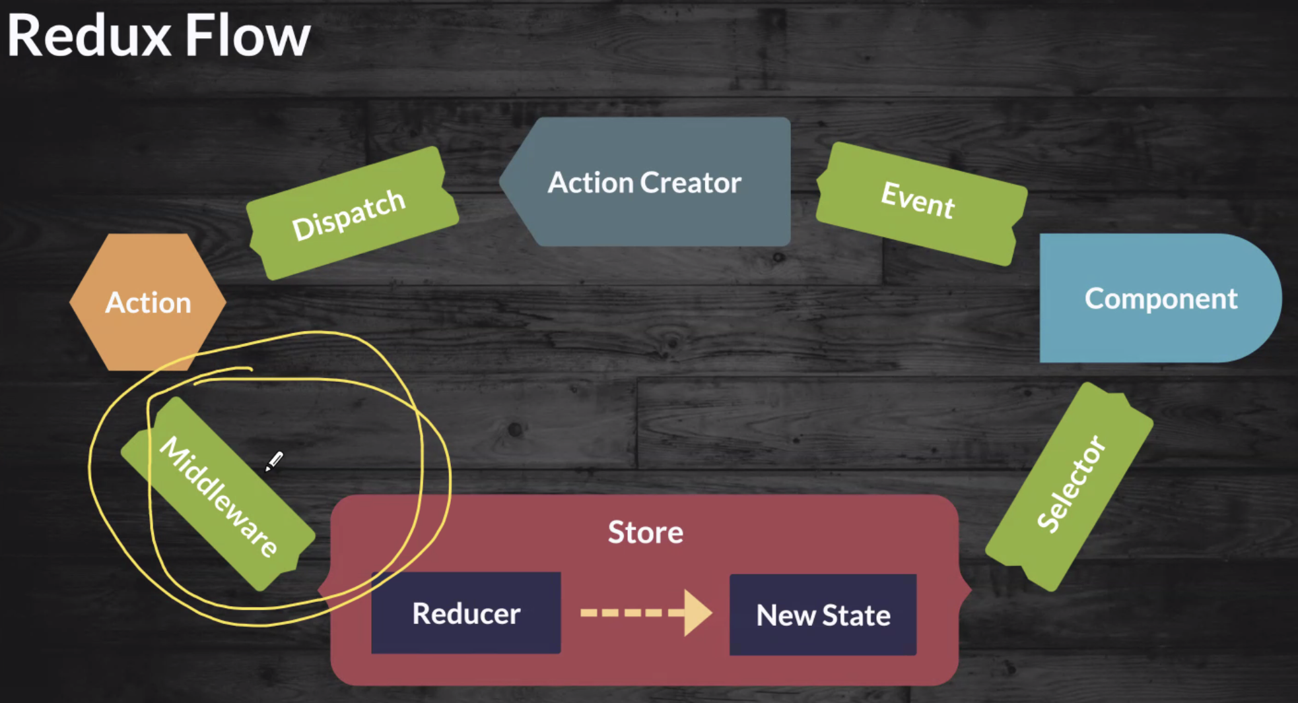

Slide 2
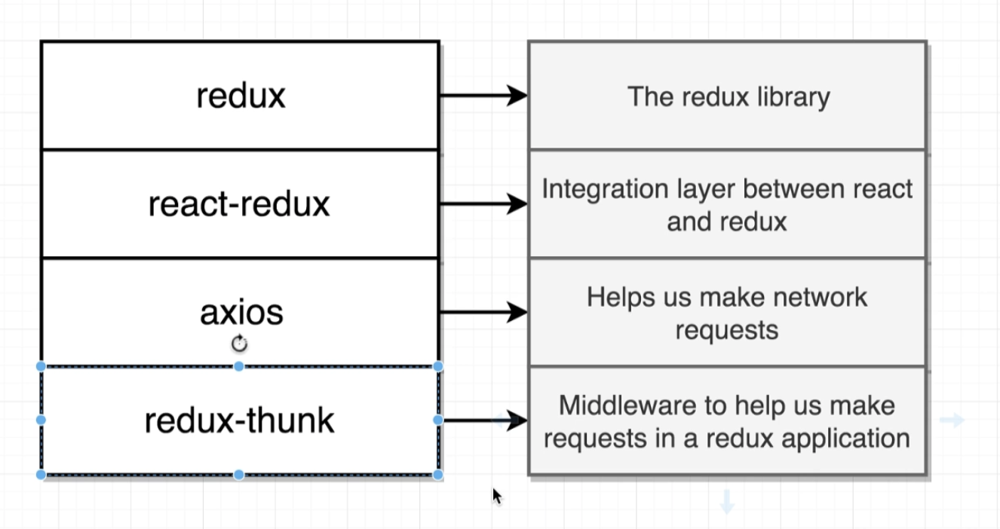

Slide 3
Redux Flow
React Rending Logic With Redux Store
Custom Hook
Res
Rest
Req
Use Selector hook to read state properties, we can also do some manipulation here to avoid duplicate state
Use Dispatch hook along with bindActionCreator to bind Actions to properties that will be used by UI as callback functions
Actions
Reducer
Redux Store
Redux store refers to the combined reducer
Combination of state data and the reducers
Store
React
REDUCERS
Hook
A Reducer for each state representation/property (cars, sort col, sort dir, edit id etc.). Pure functions cannot cause side effect. Not allowed to make ajax call
Combine multiple reducer and it makes the payload that redux will contrast using different reducers
Selector
ACTIONS
Something external to the system that tries to change the system. (Outbound calls here)
Action Type
Action Payload

Slide 4
Thunk Middleware Flow
useCarToolReduxStore.js
const actions = useMemo( () => bindActionCreators({
refreshCars,
//addCar: createAddAction,
addCar: addCarFn,
editCar: createEditAction,
saveCar: createSaveAction,
deleteCar: createDeleteAction,
cancelCar: createCancelAction,
sortCars: createSortAction
}, dispatch), [dispatch]); //dispatch never changes
useEffect( () => {
actions.refreshCars(); //stale closure as every render bind creates new refreshColors
}, [actions]); //actions changes every single render, thats the problem
Custom Hook
Use Selector hook to read state properties, we can also do some manipulation here to avoid duplicate state
Use Dispatch hook along with bindActionCreator to bind Actions to properties that will be used by UI as callback functions
Make sure we do initially request to fetch data to display
useEffect & Hook to use to useMemo
Redux Store
carToolStore.js
import { createStore, applyMiddleware } from 'redux';
import { itemReducer } from '../reducers/carToolReducers';
import thunk from 'redux-thunk';
export const carToolStore = createStore(
itemReducer,
applyMiddleware(thunk),
);
Use Thunk Middleware
REDUCERS
A Reducer for each state representation/property (cars, sort col, sort dir, edit id etc.). Pure functions cannot cause side effect. Not allowed to make ajax call hence doing it in Actions.
Combine multiple reducers and it makes the payload that redux will contrast using different reducers
Add Logic to refresh state
carToolActions.js
export const createAddCarsRequestAction = ({type: ADD_CARS_REQUEST_ACTION});
export const createAddCarsDoneAction = (car) => (
{type: ADD_CARS_REQUEST_ACTION, payload: car}
);
export const addCarFn = (car) => {
return dispatch => {
dispatch(createAddCarsRequestAction());
return addCar(car).then( car => {
dispatch(refreshCars());
})
};
};
ACTIONS
Async Calls to External System goes here.
Dispatch to Request Action – Sending request
Processing results
Dispatch Done Action – Task Completed

Slide 5
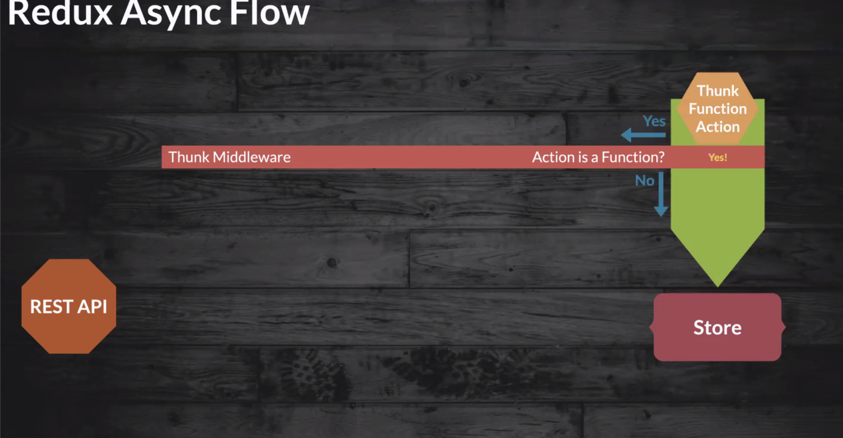

Slide 6
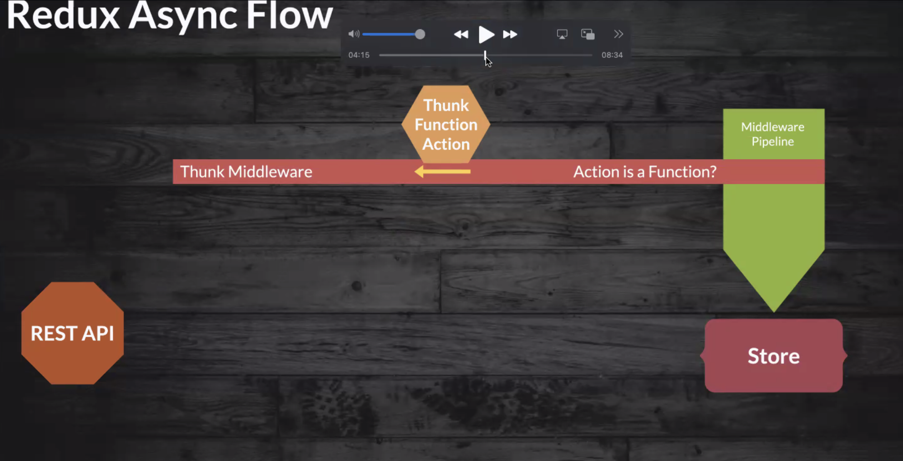

Slide 7
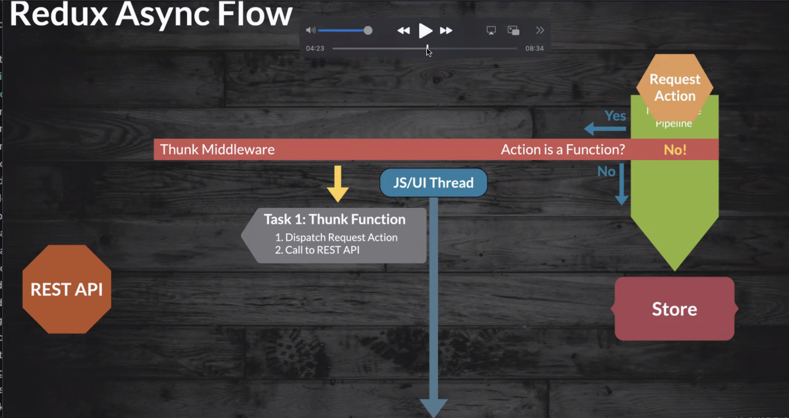

Slide 8
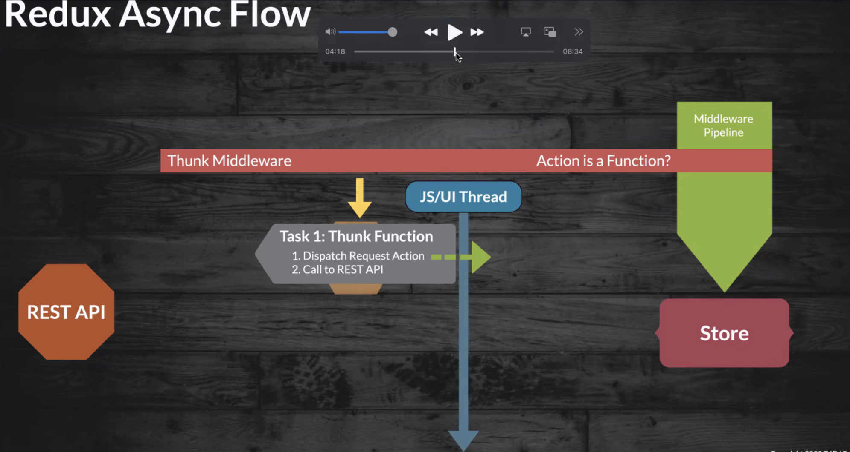

Slide 9
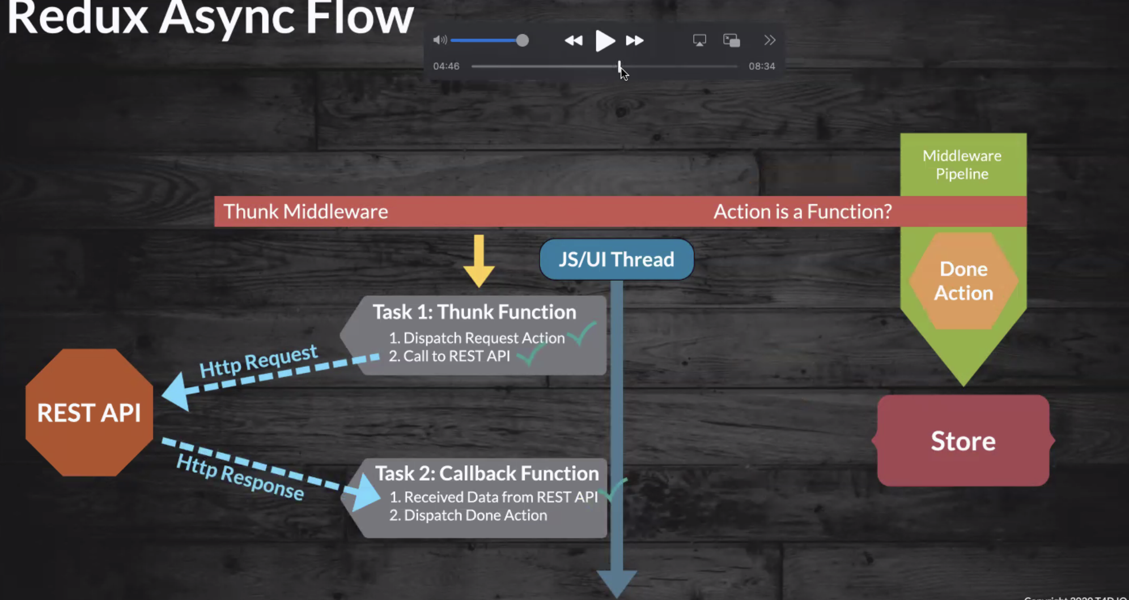

Slide 10
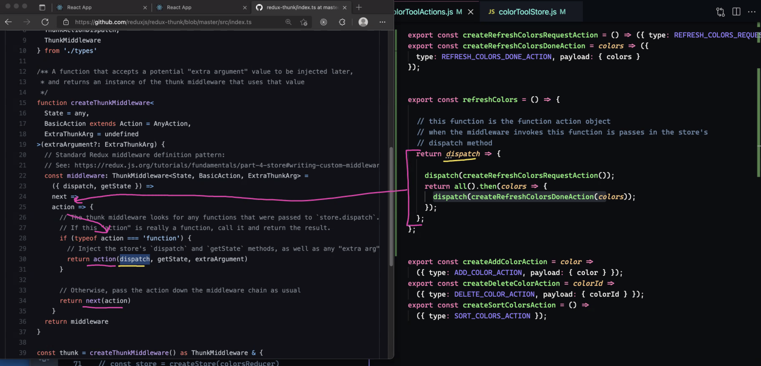
//it is the function action object that intercepted by middleware
//when the middleware invokes this function is passes in the store's dispatch method

Slide 11
Tools
https://www.javatpoint.com/json-server
https://jsonplaceholder.typicode.com
https://graphqlzero.almansi.me/
https://mocki.io/graphql

